Slide 1



Amazon Prime
Movies & TV Show
REVOU
Exploratory Data Analysis
BY
Fanysia Helena Kosuwandi
Fanysia Helena K.
PRESENTED BY

Slide 2

About the Dataset
Amazon Prime Video is a streaming service that offers a vast collection of movies, TV shows, and original content. Subscribers can access exclusive Amazon Originals, popular films, and series across various genres. The service is available on multiple devices, including smart TVs, smartphones, and tablets. Prime Video is included with an Amazon Prime membership or can be subscribed to separately in select regions.
Dataset Source: Kaggle
Tools: Google Sheets, Looker Studio

Slide 3

List Of Point
1 | Most Common Content Types on Amazon Prime Video
2 | Most Common Age Ratings on Amazon Prime Video
3 | Top Countries Releasing Content on Amazon Prime Video
4 | Top 10 Genres on Amazon Prime Video
5 | Year with the Most Content Released on Amazon Prime Video

Slide 4
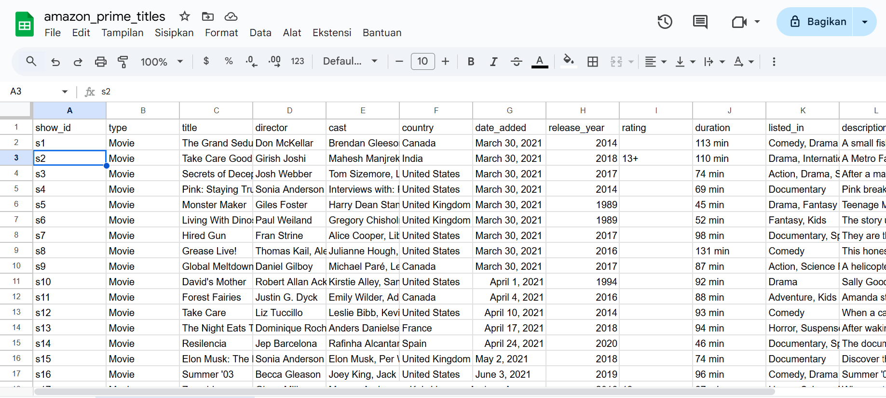
DATA PREPARATION
ORIGINIAL DATA
THE ORIGINAL DATA, WITH A TOTAL OF 9,668 ENTRIES, WITH 12 COLUMN AND STILL CONTAINS MISSING VALUES.

Slide 5
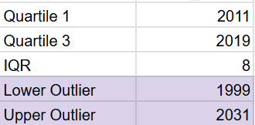
DATA FILTERING & CLEANING
IDENTIFYING OUTLIERS
BASED ON YEAR
FROM THIS IDENTIFICATION, THE YEARS 1999 AND 2031 ARE CATEGORIZED AS THE LOWER AND UPPER BOUNDS. ANY DATA OUTSIDE THIS RANGE IS CONSIDERED AN OUTLIER. THESE OUTLIERS MAY RESULT IN UNUSUAL DATA PATTERNS.

Slide 6
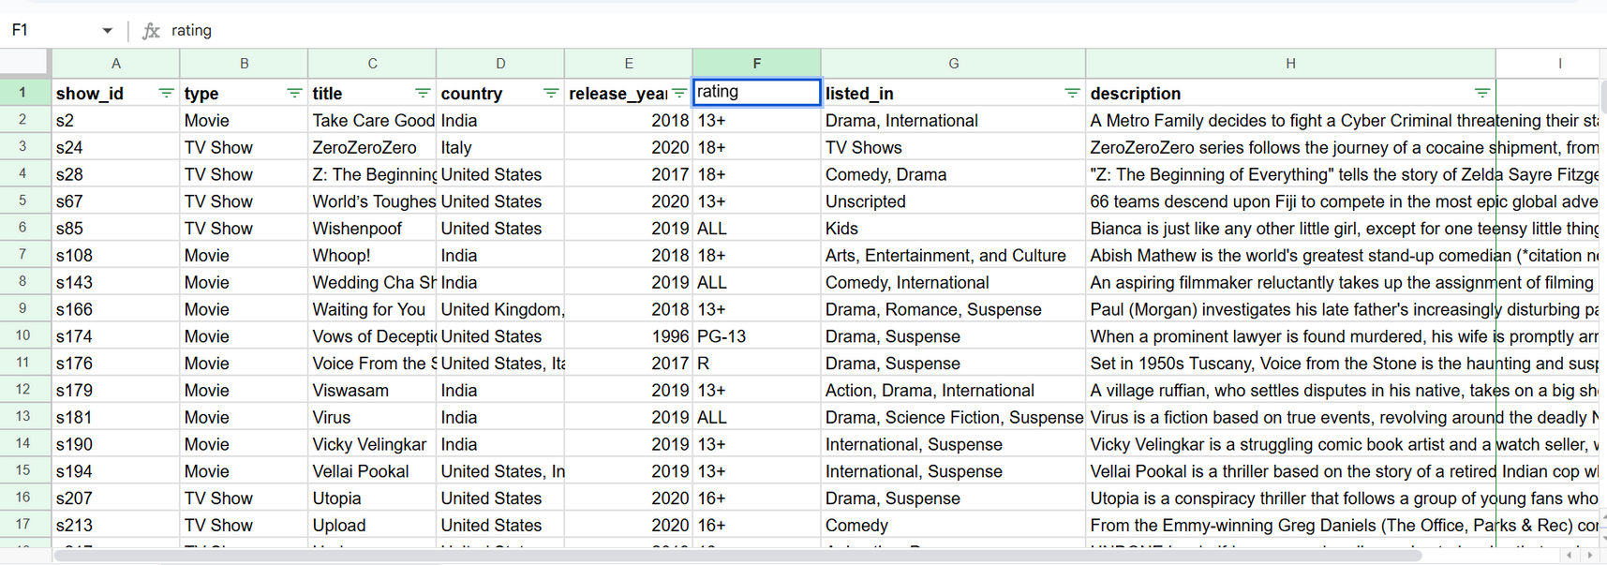
DATA FILTERING & CLEANING
DATA AFTER FILTERING AND CLEANING
After data cleaning and filtering based on the list of points, the dataset now contains 593 entries with 8 columns. There are no outliers, as all data falls within the range of 1999 to 2031.

Slide 7
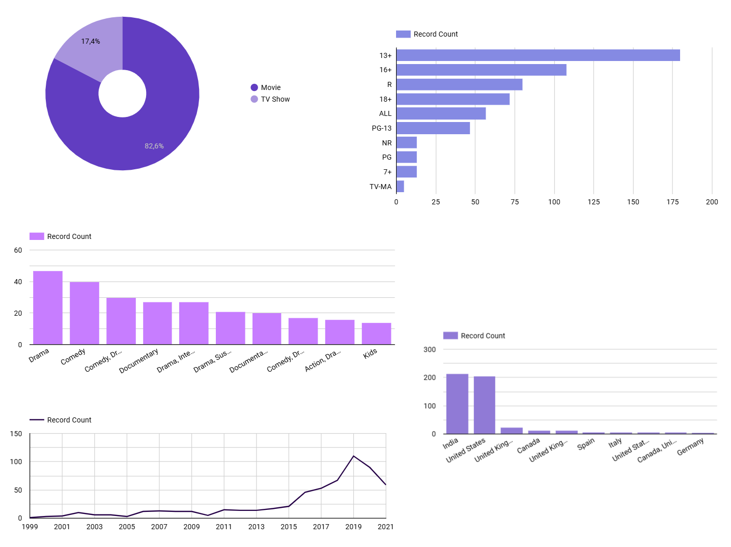
DATA VISUALIZATION

Slide 8
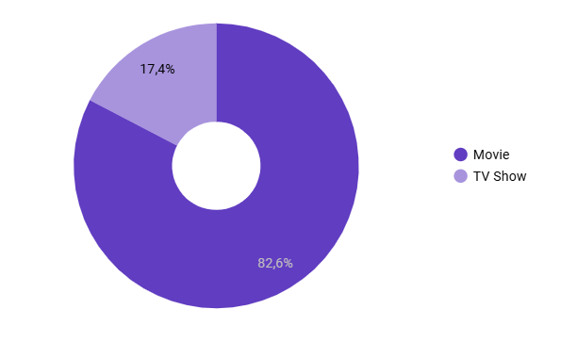
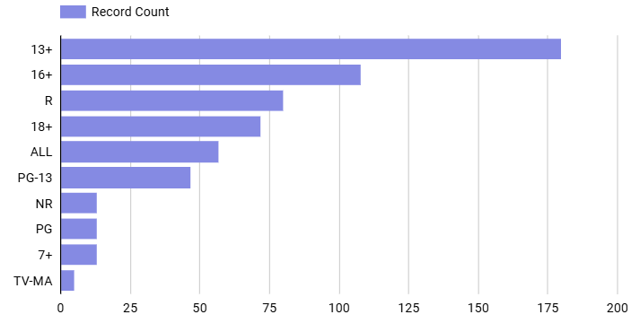
DATA VISUALIZATION
MOST COMMON CONTENT TYPES ON AMAZON PRIME VIDEO
In this analysis, it is clear that the most common type of content on Amazon Prime Video is movies, accounting for 82.6%, while TV shows account for only 17.4%. This indicates that Movies dominate the platform's content library.
MOST COMMON AGE RATINGS ON AMAZON PRIME VIDEO
This analysis shows that the most common age-rated content is 13+, with a total of 180 titles. This indicates that the platform is primarily offering content suitable for teenagers and above.

Slide 9
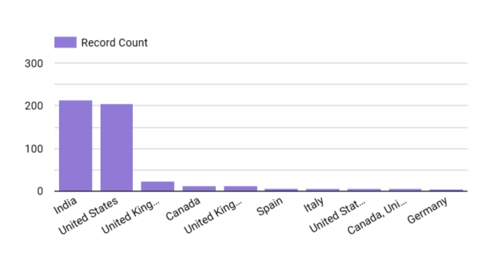
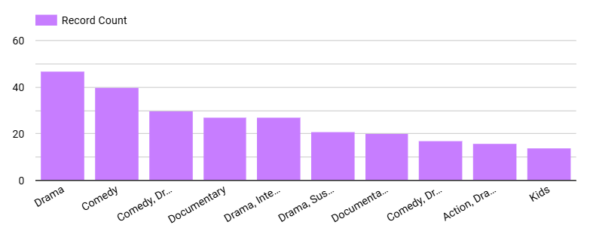
DATA VISUALIZATION
TOP COUNTRIES RELEASING CONTENT ON AMAZON PRIME VIDEO
This analysis shows that India is the top country releasing content on Amazon Prime Video, with a total of 213 titles. This highlights India's significant contribution to the platform's content library.
TOP 10 GENRES ON AMAZON PRIME VIDEO
This analysis shows that drama is the top genre on Amazon Prime Video with a total of 47 titles, followed by comedy in second place with 40 titles. This demonstrates the platform's strong focus on these genres.

Slide 10
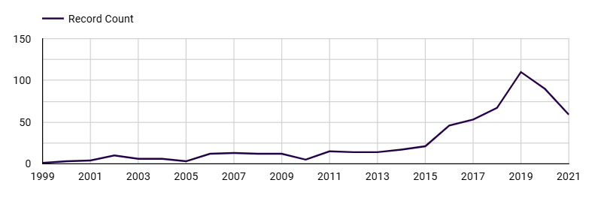
DATA VISUALIZATION
YEAR WITH THE MOST CONTENT RELEASED ON AMAZON PRIME VIDEO
In this analysis, the year with the highest number of content releases from 1999 to 2021 is 2019, with a total of 110 titles. This indicates a peak in content releases in that year.

Slide 11


Thank You
REVOU

